Slide 1
CUSTOM PAYLOAD ENCODER & OBFUSCATION FRAMEWORKSECURITY
This project demonstrates how encoded and obfuscated payloads can bypass static signature-based detection systems in a controlled lab environment.
BY: U M MOHAMED YUSUF SHERIFF
DATE: JAN 29/01/2026

Slide 2

ABSTRACT
Signature-based security systems rely on matching predefined static patterns to detect malicious payloads. However, simple encoding and obfuscation techniques can alter payload structure without changing its functionality.
This project implements a custom payload encoding framework to demonstrate how static detection systems can be bypassed using safe and controlled techniques in a laboratory environment.

Slide 3
PROBLEM STATEMENT
Most traditional antivirus and intrusion detection systems depend on static signature matching to identify malicious commands or payloads.
When payloads are encoded or obfuscated, their visible structure changes, making it difficult for signature-based systems to detect them.
Understanding these evasion techniques is essential for improving defensive cybersecurity strategies.

Slide 4
OBJECTIVES
The main objectives of this project are:
To design and implement a payload encoding framework
To apply encoding and obfuscation techniques such as XOR and ROT13
To simulate a signature-based detection mechanism
To compare detection results between original and encoded payloads
To analyze the effectiveness of detection evasion

Slide 5

SCOPE & ETHICS
Scope:
This project focuses only on text-based payloads executed in an isolated lab environment. The detection mechanism simulates static signature scanning without interacting with real-world systems.
Ethics:
No real malware, exploitation, or unauthorized access is performed. The project is strictly for academic and educational purposes to understand defensive security concepts.

Slide 6
TOOLS & ENVIRONMENT
The project was implemented using:
Kali Linux running in a virtual machine
Python 3 programming language
Terminal and text editor for development
Offline or NAT network configuration for safe testing
All experiments were conducted in a controlled environment.

Slide 7
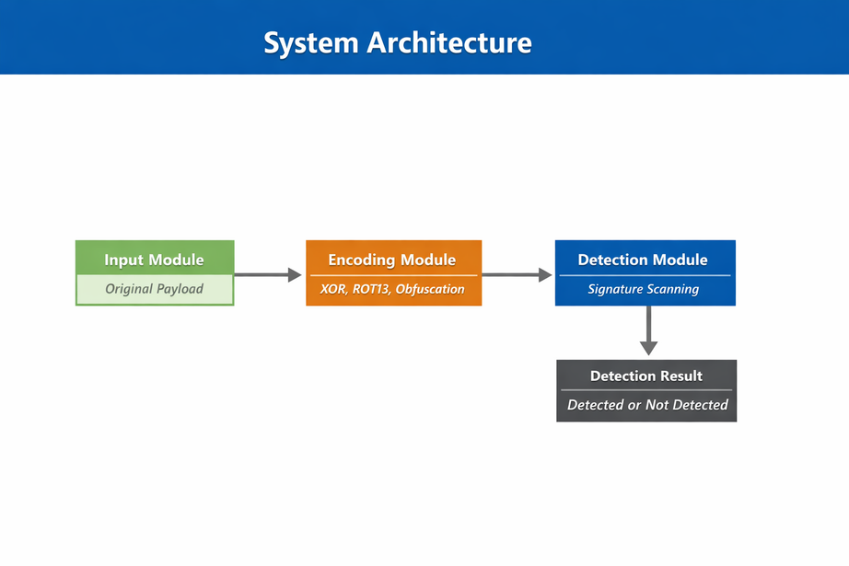
SYSTEM ARCHITECTURE
The system consists of three main components:
Input Module – Accepts the original payload
Encoding Module – Applies XOR, ROT13, or obfuscation
Detection Module – Scans for signature patterns
The detection result is then displayed as “Detected” or
“Not Detected”.

Slide 8
ENCODING & OBFUSCATION TECHNIQUES
The project implements the following techniques:
XOR Encoding:
Uses a secret key to transform payload characters into unreadable format.
ROT13 Encoding:
Applies a substitution cipher that shifts alphabet characters by 13 positions.
String Obfuscation:
Breaks known patterns using delimiters or character separation to avoid detection.
These techniques modify appearance without changing logic.

Slide 9
DETECTION MECHANISM
The detection system uses keyword-based static signature scanning.
It searches for predefined command patterns within the payload.
If a known pattern is found, the payload is marked as “Detected.”
If no match is found, it is marked as “Not Detected.”
This simulates how traditional static antivirus systems operate.

Slide 10
RESULTS
The results show a clear difference between original and encoded payloads:
The original payload was successfully detected.
XOR encoded payload bypassed detection.
ROT13 encoded payload bypassed detection.
Obfuscated payload also bypassed detection.
This demonstrates the weakness of simple signature-based systems.

Slide 11
CONCLUSION
The project proves that static signature-based detection systems can be bypassed using simple encoding and obfuscation techniques.
While the original payload was detected, encoded versions evaded detection successfully.
This highlights the need for advanced detection mechanisms such as behavioral analysis and heuristic scanning.

